Slide 1
The Biba Model
Contrary to Bell-LaPadula model, in Biba model information can only flow from a higher integrity class to a lower integrity class.
L is a linearly ordered set of integrity levels
C is a lattice of integrity categories
Integrity levels form a linear lattice in which each level represents the classification of integrity of information an object can contain or the clearance of a subject for modifying an object.
Integrity categories form a subset lattice and are used to enforce the need-to-have principle.
The lattice of security classes is L × C.

Slide 2
The Biba Model contd…
Security with respect to integrity in the Biba model is described by the following two axioms:
Simple security property: Writing information to an object o by a subject s requires that SC(s) dominates SC(o) (“no write up”).
The*-property: Reading information from an object o by a subject s requires that SC(o) dominates SC(s) ( “no read down”).

Slide 3
Multilevel Integrity (2)
Big potential application – control systems
E.g. in future “smart grid”
Safety: highest integrity level
Control: next level
Monitoring (SCADA): third level
Enterprise apps (e.g. billing): fourth level
Complexity: prefer not to operate plant if SCADA system down (though you could)
So a worm attack on SCADA can close an asset
Ross Anderson

Slide 4
Multilevel Integrity (3)
LOMAC was an experimental Linux system with system files at High, network at Low
A program that read traffic was downgraded
Vista adopted this – marks objects Low, Medium, High or System, and has default policy of NoWriteUp
Critical stuff is System, most other stuff is Medium, IE is Low
Could in theory provide good protection – in practice, UAC (User account control in Windows) trains people to override it!
Ross Anderson

Slide 5
Comparison of two Multilevel Models
The Bell-LaPadula Model is concerned with information confidentiality
subjects reading from an object must have higher a security class than the object.
objects being written to by a subject must have higher security class than the subject.
The Biba model emphasizes information integrity
subjects writing information to an object must have higher a security class than the object.
objects being read from by a subject must have higher security class than the subject.
Ross Anderson

Slide 6
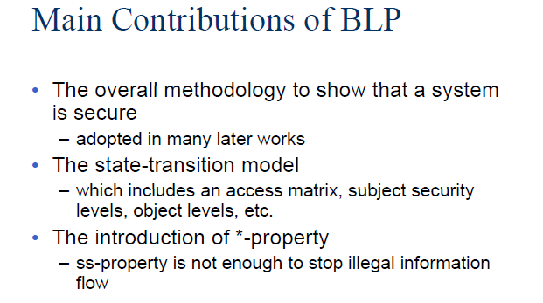
Does not deal with information flow through covert channels

Slide 7
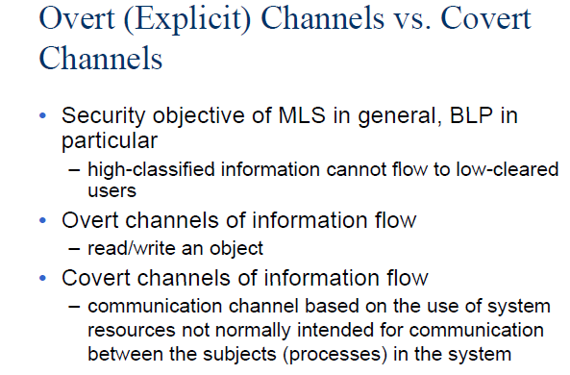

Slide 8
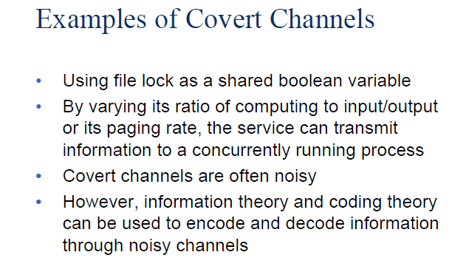

Slide 9
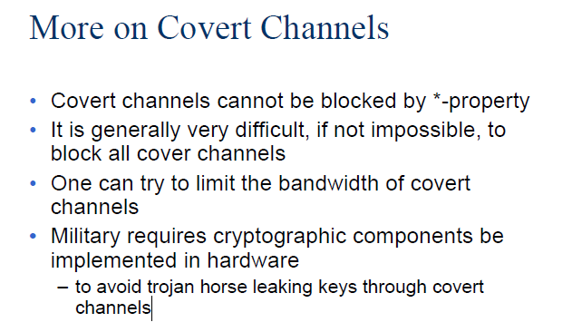

Slide 10
Requests by a subject to access an object are controlled with respect to the access class of the subject and the object and granted only if some relationship, depending on the requested access, is satisfied
Two principles, must be satisfied to protect information confidentiality
No-read-up: A subject is allowed a read access to an object only if the access class of the subject dominates the access class of the object
No-write-down: A subject is allowed a write access to an object only if the access class of the subject is dominated by the access class of the object

Slide 11
Satisfaction of these two principles prevents information to flow from high level subjects/objects to subjects/objects at lower (or incomparable) levels, thereby ensuring the satisfaction of the protection requirements (i.e., no process will be able to make sensitive information available to users not cleared for it)
It is important to control both read and write operations, since both can be improperly used to leak information

Slide 12
Consider the earlier example of the Trojan Horse
Possible classifications reflecting the access restrictions to be enforced could be: Secret for Vicky and Market, and Unclassified for John and Stolen
In the respect of the no-read-up and no-write-down principles, the Trojan Horse will never be able to complete successfully
If Vicky connects to the system as a Secret (or Confidential) subject, and thus the application runs with a Secret (or Confidential) access class, the write operation will be blocked
If Vicky invokes the application as an Unclassified subject, the read operation will be blocked instead

Slide 13
Given the no-write-down principle, users are allowed to connect to the system at different access classes, so that they are able to access information at different levels (provided that they are cleared for it)
A lower class does not mean “less” privileges in absolute terms, but only less reading privileges
Although users can connect to the system at any level below their clearance, the strict application of the no-read-up and the no-write-down principles may result too rigid

Slide 14
Real world situations often require exceptions to the mandatory restrictions
data may need to be downgraded
information released by a process may be less sensitive than the information the process has read
To respond to situations like these, multilevel systems should then allow for exceptions, loosening or waiving restrictions, in a controlled way, to processes that are trusted and ensure that information is sanitized (meaning the sensitivity of the original information is lost)

Slide 15
Note also that DAC and MAC policies are not mutually exclusive, but can be applied jointly
In this case, an access to be granted needs both
the existence of the necessary authorization for it and
to satisfy the mandatory policy
Intuitively, the discretionary policy operates within the boundaries of the mandatory policy: it can only restrict the set of accesses that would be allowed by MAC alone

Slide 16
Multilateral Security

Slide 17
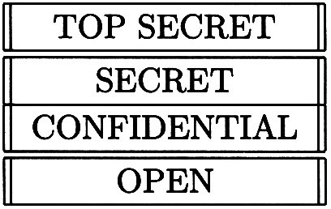
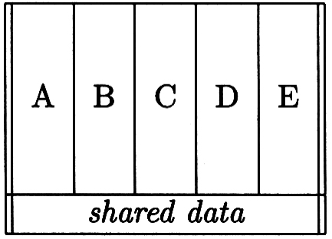
Multilateral Security
Sometimes the aim is to stop data flowing down
Other times, you want to stop lateral flows
Examples:
Intelligence
Competing clients of an accounting firm
Medical records by practice or hospital

Slide 18
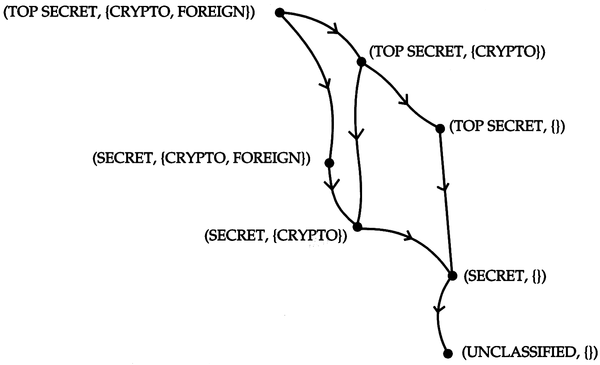
The Lattice Model
This is how intelligence agencies manage ‘compartmented’ data – by adding labels
Basic idea: BLP requires only a partial order

Slide 19
The Chinese Wall Model
Industries such as investment banking, advertising and accounting have too few top firms for each big client to have its own
So maybe you’re auditing BP, and Shell too!
Traditional control: a “Chinese Wall” rule that stops the two teams communicating
Idea (Brewer and Nash, 1989): use a refinement of Bell-LaPadula

Slide 20
The Chinese Wall Model (2)
Idea: it’s not enough to stop a Shell analyst reading BP data
Must stop a BP analyst writing data to a Barclays file that the Shell analyst can also read
For each object O, let y(O) be the firm it relates to
Let x(O) be that firm’s conflict-of-interest class
Let x(O) = Ø if the information has been sanitized (so anyone can see it)

Slide 21
The Chinese Wall Model (3): in Summary
Then reading is allowed if the object belongs to a firm the subject has access to, or a different conflict-of-interest class
S can read O iff for all O' to which S has access, y(O)=y(O') or x(O) ∉ x(O')
Writing is allowed iff the user cannot read an object that contains unsanitised information
S can write O iff S cannot read O' with y(O)≠y(O') and x(O)≠ Ø
Practical issues: where is the state kept? Should you automate this at all?

Slide 22
Chinese Wall Model

Slide 23
Chinese Wall Model (from Matt Bishop)

Slide 24
Chinese Wall Model
Problem:
Tony advises American Bank about investments
He is asked to advise Toyland Bank about investments
Conflict of interest to accept, because his advice for either bank would affect his advice to the other bank

Slide 25
Organization
Organize entities into “conflict of interest” classes
Control subject accesses to each class
Control writing to all classes to ensure information is not passed along in violation of rules
Allow sanitized data to be viewed by everyone

Slide 26
Definitions
Objects: items of information related to a company
Company dataset (CD): contains objects related to a single company
Written CD(O)
Conflict of interest class (COI): contains datasets of companies in competition
Written COI(O)
Assume: each object belongs to exactly one COI class

Slide 27
Example
Bank COI Class
Gasoline Company COI Class
Bank of
America
Shell Oil
Standard Oil
Citibank
Bank of the
W
est
Union ’76
ARCO

Slide 28
Temporal Element
If Anthony reads any CD in a COI, he can never read another CD in that COI
Possible that information learned earlier may allow him to make decisions later
Let PR(S) be set of objects that S has already read

Slide 29
CW-Simple Security Condition
s can read o iff either condition holds:
There is an o′ such that s has accessed o′ and CD(o′) = CD(o)
Meaning s has read something in o’s dataset
For all o′ ∈ O, o′ ∈ PR(s) ⇒ COI(o′) ≠ COI(o)
Meaning s has not read any objects in o’s conflict of interest class
Ignores sanitized data (see below)
Initially, PR(s) = ∅, so initial read request granted

Slide 30
Sanitization
Public information may belong to a CD
As is publicly available, no conflicts of interest arise
So, should not affect ability of analysts to read
Typically, all sensitive data removed from such information before it is released publicly (called sanitization)
Add third condition to CW-Simple Security Condition:
3. o is a sanitized object

Slide 31
Writing
Anthony, Susan work in same trading house
Anthony can read Bank 1’s CD, Gas’ CD
Susan can read Bank 2’s CD, Gas’ CD
If Anthony could write to Gas’ CD, Susan can read it
Hence, indirectly, she can read information from Bank 1’s CD, a clear conflict of interest

Slide 32
CW-*-Property
s can write to o iff both of the following hold:
The CW-simple security condition permits s to read o; and
For all unsanitized objects o′, if s can read o′, then CD(o′) = CD(o)
Says that s can write to an object if all the (unsanitized) objects it can read are in the same dataset

Slide 33
Formalism
Goal: figure out how information flows around system
S set of subjects, O set of objects, L = C×D set of labels
l₁:O→C maps objects to their COI classes
l₂:O→D maps objects to their CDs
H(s, o) true iff s has or had read access to o
R(s, o): Request from s to read o

Slide 34
Axioms
Axiom 1. For all o, o′ ∈ O, if l₂(o) = l₂(o′), then l₁(o) = l₁(o′)
CDs do not span COIs.
Axiom 2. s ∈ S can read o ∈ O iff,
for all o′ ∈ O such that H(s, o′), either l₁(o′) ≠ l₁(o) or l₂(o′) = l₂(o)
s can read o iff o is either in a different COI than every other o′ that s has read, or in the same CD as o.

Slide 35
Which Objects Can Be Read?
Suppose s ∈ S has read o ∈ O.
If s can read o′ ∈ O, o′ ≠ o, then l₁(o′ ) ≠ l₁(o) or l₂(o′ ) = l₂(o).
Says s can read only the objects in a single CD within any COI

Slide 36
Proof
Assume false. Then
H(s, o) ∧ H(s, o′) ∧ l₁(o′) = l₁(o) ∧ l₂(o′) ≠ l₂(o)
Assume s read o first.
Then H(s, o) when s read o, so by Axiom 2,
either l₁(o′) ≠ l₁(o) or l₂(o′) = l₂(o), so
(l₁(o′) ≠ l₁(o) ∨ l₂(o′) = l₂(o)) ∧ (l₁(o′) = l₁(o) ∧ l₂(o′) ≠ l₂(o))
Rearranging terms,
(l₁(o′) ≠ l₁(o) ∧ l₂(o′) ≠ l₂(o) ∧ l₁(o′) = l₁(o)) ∨
(l₂(o′) = l₂(o) ∧ l₂(o′) ≠ l₂(o) ∧ l₁(o′) = l₁(o))
which is obviously false, contradiction.

Slide 37
Lemma
Suppose a subject s ∈ S can read an object o ∈ O. Then s can read no o′ for which l₁(o′) = l₁(o) and l₂(o′) ≠ l₂(o).
So a subject can access at most one CD in each COI class
Sketch of proof:
Initial case follows from Axioms 3-4.
If o′ ≠ o, theorem immediately gives lemma.

Slide 38
COIs and Subjects
Theorem: Let c ∈ C and d ∈ D. Suppose there are n objects o_{i} ∈ O, 1 ≤ i ≤ n, such that l₁(o_{i}) = d for 1 ≤ i ≤ n, and l₂(o_{i}) ≠ l₂(o_{j}), for 1 ≤ i, j ≤ n, i ≠ j. Then for all such o, there is an s ∈ S that can read o iff n ≤ |S|.
If a COI has n CDs, you need at least n subjects to access every object
Proof sketch: If s can read o, it cannot read any o′ in another CD in that COI (Axiom 2). As there are n such CDs, there must be at least n subjects to meet the conditions of the theorem.

Slide 39
Sanitized Data
v(o): sanitized version of object o
For purposes of analysis, place them all in a special CD in a COI containing no other CDs
Axiom 5. l₁(o) = l₁(v(o)) iff l₂(o) = l₂(v(o))

Slide 40
Which Objects Can Be Written?
Axiom 6. s ∈ S can write to o ∈ O iff the following hold simultaneously
H(s, o)
There is no o′ ∈ O with H(s, o′), l₂(o) ≠ l₂(o′), l₂(o) ≠ l₂(v(o)), l₂(o′) = l₂(v(o)).
Allow writing iff information cannot leak from one subject to another through a mailbox
Note handling for sanitized objects

Slide 41
How Information Flows
Definition: Information may flow from o to o′ if there is a subject such that H(s, o) and H(s, o′).
Intuition: if s can read 2 objects, it can act on that knowledge; so information flows between the objects through the nexus of the subject
Write the above situation as (o, o′)

Slide 42
Key Result
Set of all information flows is
{ (o, o′) | o ∈ O ∧ o′ ∈ O ∧ l₂(o) = l₂(o′) ∨ l₂(o) = l₂(v(o)) }
Sketch of proof: Definition gives set of flows:
F = {(o, o′) | o ∈ O ∧ o′ ∈ O ∧ ∃ s ∈ S such that H(s, o) ∧ H(s, o′))}
Axiom 6 excludes the following flows:
X = { (o, o′) | o ∈ O ∧ o′ ∈ O ∧ l₂(o) ≠ l₂(o′) ∧ l₂(o) ≠ l₂(v(o)) }
So, letting F* be transitive closure of F,
F* – X = {(o, o′) | o ∈ O ∧ o′ ∈ O ∧ ¬(l₂(o) ≠ l₂(o′) ∧ l₂(o) ≠ l₂(v(o))) }
which is equivalent to the claim.

Slide 43
Comparison with Bell-LaPadula
Fundamentally different
CW has no security labels, B-LP does
CW has notion of past accesses, B-LP does not
Bell-LaPadula can capture state at any time
Each (COI, CD) pair gets security category
Two clearances, S (sanitized) and U (unsanitized)
S dom U
Subjects assigned clearance for compartments without multiple categories corresponding to CDs in same COI class

Slide 44
Comparison with Bell-LaPadula
Bell-LaPadula cannot track changes over time
Susan becomes ill, Anna needs to take over
C-W history lets Anna know if she can
No way for Bell-LaPadula to capture this
Access constraints change over time
Initially, subjects in C-W can read any object
Bell-LaPadula constrains set of objects that a subject can access
Can’t clear all subjects for all categories, because this violates CW-simple security condition

Slide 45
Clinical Information Systems Security Policy

Slide 46
Clinical Information Systems Security Policy
Intended for medical records
Conflict of interest not critical problem
Patient confidentiality, authentication of records and annotators, and integrity are
Entities:
Patient: subject of medical records (or agent)
Personal health information: data about patient’s health or treatment enabling identification of patient
Clinician: health-care professional with access to personal health information while doing job

Slide 47
Assumptions and Principles
Assumes health information involves 1 person at a time
Not always true; OB/GYN involves father as well as mother
Principles derived from medical ethics of various societies, and from practicing clinicians

Slide 48
Access
Principle 1: Each medical record has an access control list naming the individuals or groups who may read and append information to the record. The system must restrict access to those identified on the access control list.
Idea is that clinicians need access, but no-one else. Auditors get access to copies, so they cannot alter records

Slide 49
Access
Principle 2: One of the clinicians on the access control list must have the right to add other clinicians to the access control list.
Called the responsible clinician

Slide 50
Access
Principle 3: The responsible clinician must notify the patient of the names on the access control list whenever the patient’s medical record is opened. Except for situations given in statutes, or in cases of emergency, the responsible clinician must obtain the patient’s consent.
Patient must consent to all treatment, and must know of violations of security

Slide 51
Access
Principle 4: The name of the clinician, the date, and the time of the access of a medical record must be recorded. Similar information must be kept for deletions.
This is for auditing. Don’t delete information; update it (last part is for deletion of records after death, for example, or deletion of information when required by statute). Record information about all accesses.

Slide 52
Creation
Principle: A clinician may open a record, with the clinician and the patient on the access control list. If a record is opened as a result of a referral, the referring clinician may also be on the access control list.
Creating clinician needs access, and patient should get it. If created from a referral, referring clinician needs access to get results of referral.

Slide 53
Deletion
Principle: Clinical information cannot be deleted from a medical record until the appropriate time has passed.
This varies with circumstances.

Slide 54
Confinement
Principle: Information from one medical record may be appended to a different medical record if and only if the access control list of the second record is a subset of the access control list of the first.
This keeps information from leaking to unauthorized users. All users have to be on the access control list.

Slide 55
Aggregation
Principle: Measures for preventing aggregation of patient data must be effective. In particular, a patient must be notified if anyone is to be added to the access control list for the patient’s record and if that person has access to a large number of medical records.
Fear here is that a corrupt investigator may obtain access to a large number of records, correlate them, and discover private information about individuals which can then be used for nefarious purposes (such as blackmail)

Slide 56
Enforcement
Principle: Any computer system that handles medical records must have a subsystem that enforces the preceding principles. The effectiveness of this enforcement must be subject to evaluation by independent auditors.
This policy has to be enforced, and the enforcement mechanisms must be auditable (and audited)

Slide 57
Compare to Bell-LaPadula
Confinement Principle imposes lattice structure on entities in model
Similar to Bell-LaPadula
CISS focuses on objects being accessed; B-LP on the subjects accessing the objects
May matter when looking for insiders in the medical environment

Slide 58
Originator Controlled Access Control (ORCON)
Problem: organization creating document wants to control its dissemination
Example: Secretary of Agriculture writes a memo for distribution to her immediate subordinates, and she must give permission for it to be disseminated further. This is “originator controlled” (here, the “originator” is a person).

Slide 59
Requirements
Subject s ∈ S marks object o ∈ O as ORCON on behalf of organization X. X allows o to be disclosed to subjects acting on behalf of organization Y with the following restrictions:
o cannot be released to subjects acting on behalf of other organizations without X’s permission; and
Any copies of o must have the same restrictions placed on it.

Slide 60
DAC Fails
Owner can set any desired permissions
This makes 2 unenforceable

Slide 61
MAC Fails
First problem: category explosion
Category C contains o, X, Y, and nothing else. If a subject y ∈ Y wants to read o, x ∈ X makes a copy o′. Note o′ has category C. If y wants to give z ∈ Z a copy, z must be in Y—by definition, it’s not. If x wants to let w ∈ W see the document, need a new category C′ containing o, X, W.
Second problem: abstraction
MAC classification, categories centrally controlled, and access controlled by a centralized policy
ORCON controlled locally

Slide 62
Combine Them
The owner of an object cannot change the access controls of the object.
When an object is copied, the access control restrictions of that source are copied and bound to the target of the copy.
These are MAC (owner can’t control them)
The creator (originator) can alter the access control restrictions on a per-subject and per-object basis.
This is DAC (owner can control it)

